Slide 1

Leveraging Data Analytics for Strategic Decision-Making Presentation
Presenter: Skillarchie Davis
Last Updated: 23/01/24

Slide 2
PRESENTATION FLOW
Overview
Dashboard
Recommendations
Questions
Insights

Slide 3
OVERVIEW OF THE DATASET
The dataset is about banking customer data that includes customer name, gender, credit score, account balance, card type, Age, Tenure and complain satisfaction rate.

Slide 4
KEY INSIGHTS
Most of our customer has the Diamond and Gold card.
High risk customer are those adult are seniors that has a poor or fair credit score and low income.
Young Adult and Adults are our most profitable customers.
The distribution of credit type is the same for all salary type with most customer having fair and good credit followed by poor credit.
Around fifty-six (56) percent of our customers has fair or poor credit while less than twenty (20) percent has very good or excellent credit.

Slide 5
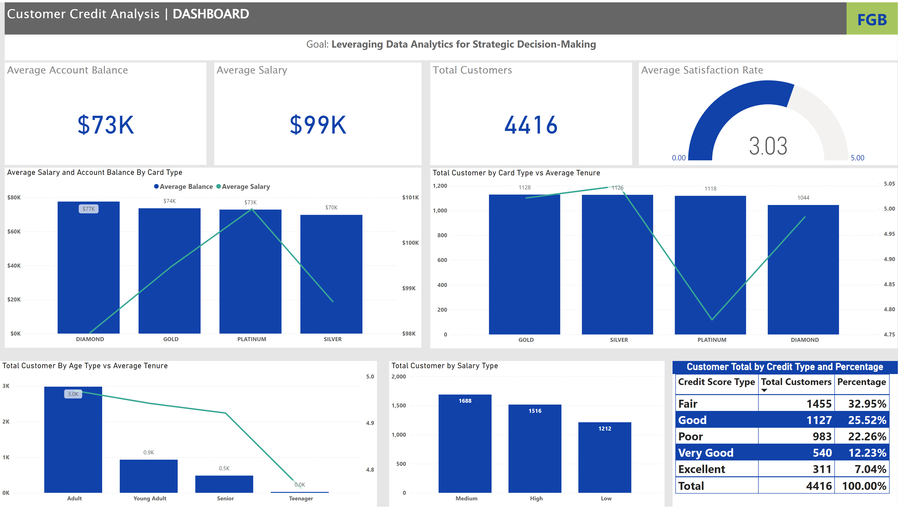
Customer Analysis
Notes:
textbox
No alt text provided
textbox
No alt text provided
Total Customer by Card Type vs Average Tenure
No alt text provided
Customer Total by Credit Type and Percentage
No alt text provided
Average Salary and Account Balance By Card Type
No alt text provided
Total Customer by Salary Type
No alt text provided
Total Customer By Age Type vs Average Tenure
No alt text provided
Average Account Balance
No alt text provided
Average Salary
No alt text provided
Total Customers
No alt text provided
Average Satisfaction Rate
No alt text provided
NCB
No alt text provided

Slide 6
RECOMMENDATION
To prevent them from becoming high-risk clients, educate teenagers and young adults about credit using workshops, webinars, campus visits, and use influencer on social media platforms like TikTok.
Organize a promotion with the goal of helping customers with fair and low credit scores restore their credit.
Offer medium-income consumers with fair or poor credit ratings and an average account balance between $50,000 and $75,000 a low-risk loan or product offering.
Provide customers with credit ratings above average with exclusive offers and product offerings.

Slide 7

Questions

